Slide 1
Ground Water Modeling Introduction
CE 547 – BRIGHAM YOUNG UNIVERSITY

Slide 2

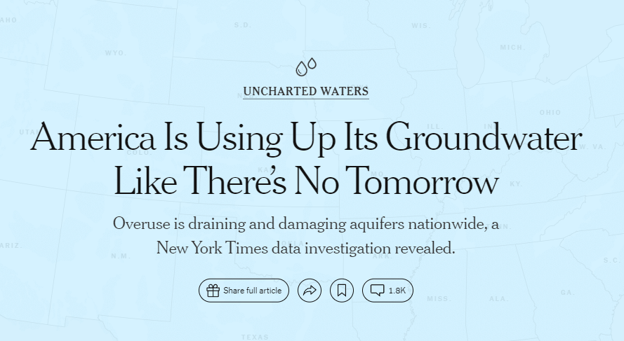

Slide 3
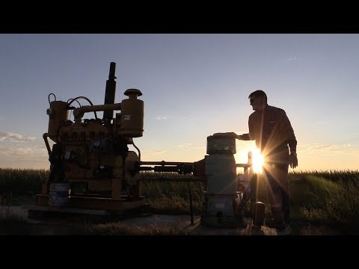
Notes:
Watch the first few minutes up to the GRACE stuff and then switch to the KANSAS part at 13:21.

Slide 4
What is a gw model?
A simplified physical or mathematical representation of an aquifer system that mimics the basic stresses and responses of the real system
The following slides illustrate a typical applications of groundwater modeling

Slide 5
The Sacramento Regional Groundwater Model
Case Study – Northern California
Notes:
Derrick Whitehead Roseville City - Roseville, CA
Norm Jones Aquaveo - Provo, UT
Michelle Smilowitz Heatwave Data - Miami, FLA

Slide 6
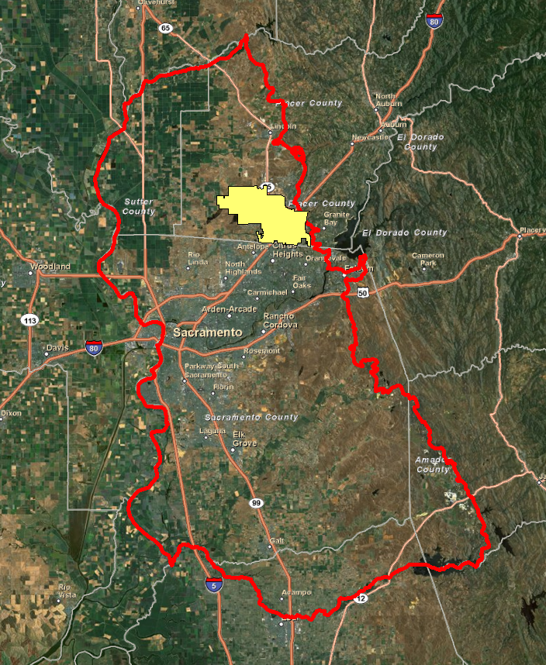
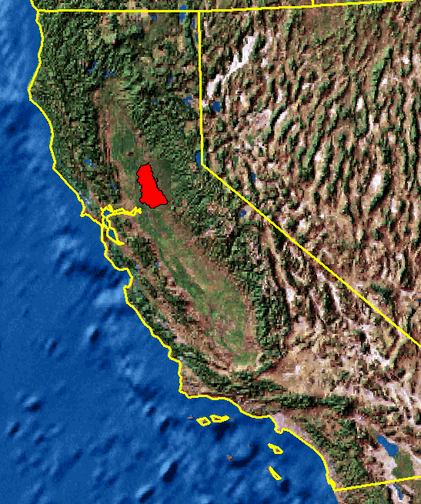
Project Setting
Roseville

Slide 7
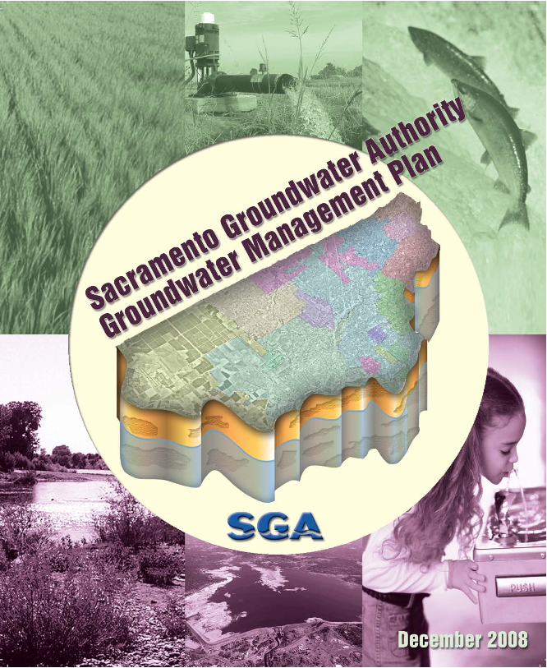
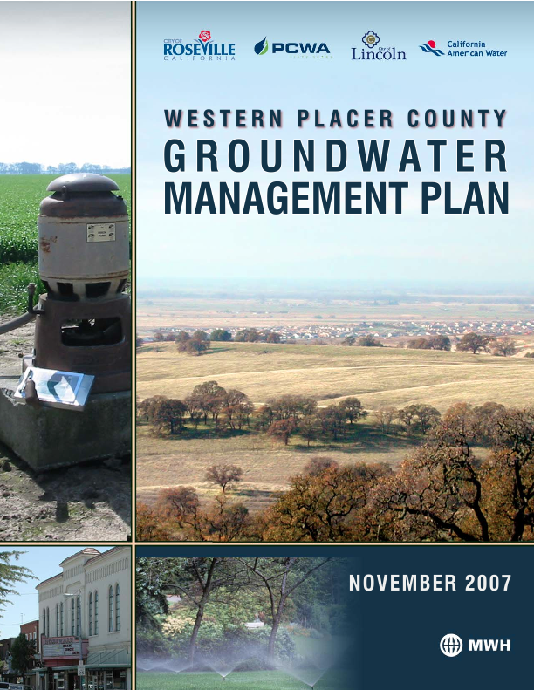
Objectives
Local-scale issues
Aquifer storage and recovery
Migration of contaminants
Regional-scale issues
Long-term demand
Water conservation strategies
Banking and exchange

Slide 8
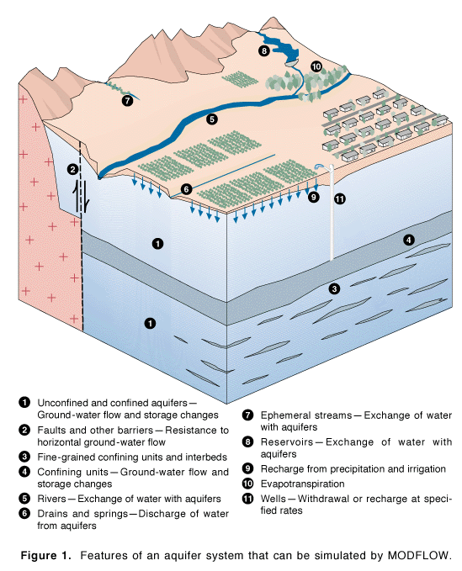

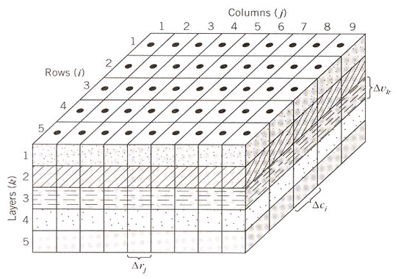
Model Selection - MODFLOW

Slide 9
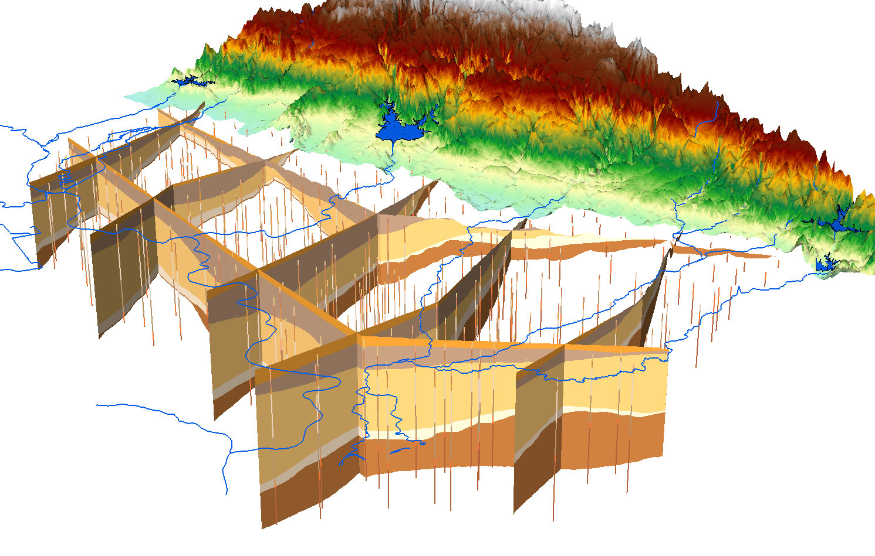
Hydrogeologic Characterization
Notes:
Using a process described in more detail in the previous presentation by Doug Gallup, we created a set of 3D cross sections made of multi-patch features.

Slide 10
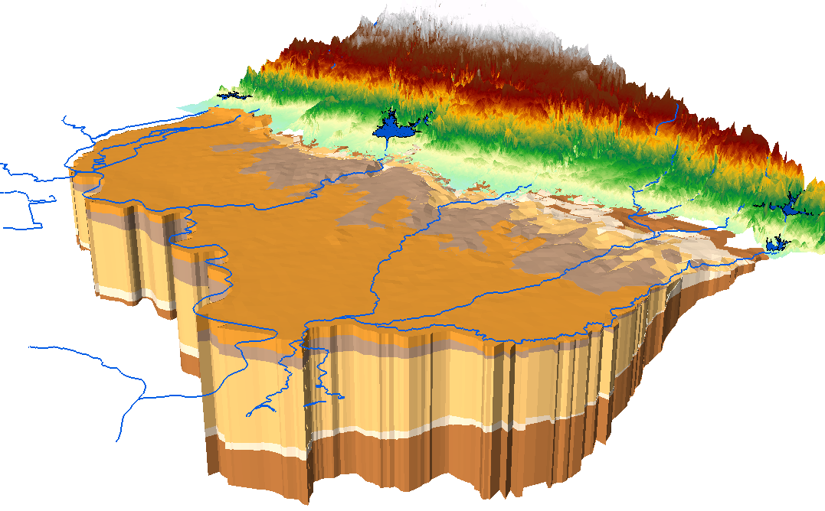
Hydrogeologic Characterization
Notes:
Using a similar process, we created a set of 3D volumetric features called GeoVolumes. Again, these are composed of multi-patches. The outcropping of the lower layers was consistent with trends observed from surficial geology maps imported from shapefiles.

Slide 11
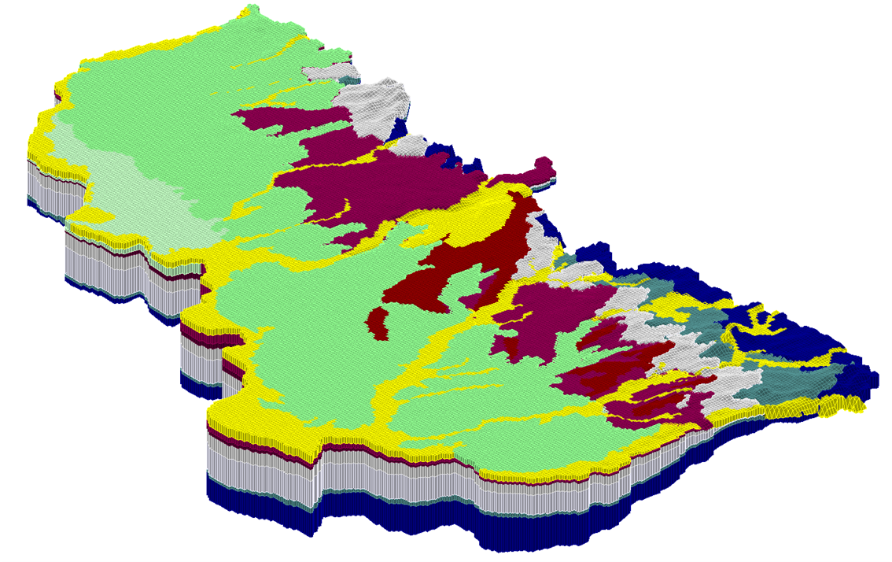
Numerical Model

Slide 12
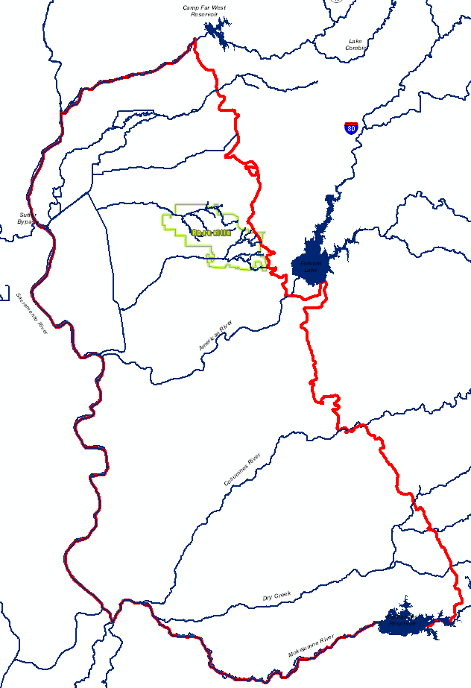
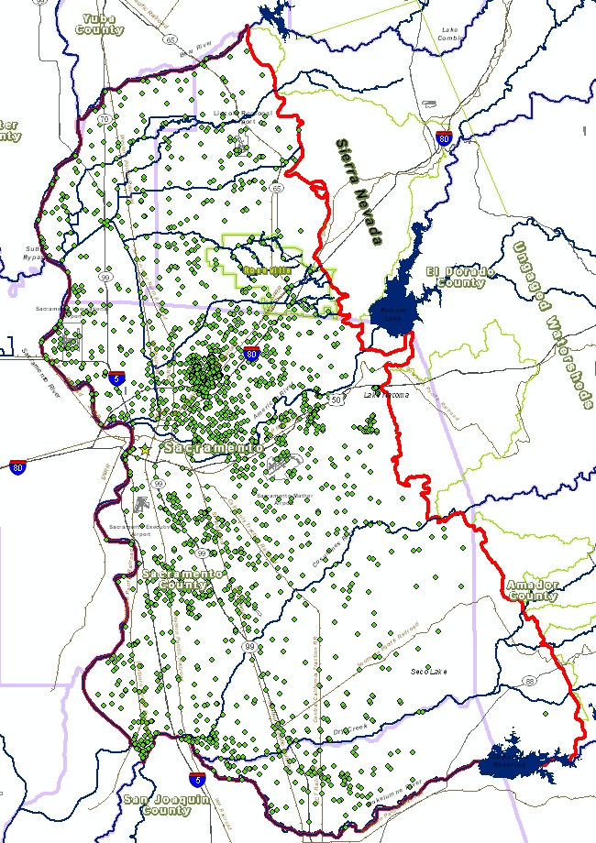
Stresses
Rivers, Streams, Canals
Wells
Notes:
Model stresses including base flow to and from streams and groundwater withdrawals from supply wells were included in the MODFLOW simulation. Given the size and scale of the regional model, ArcGIS and the Arc Hydro data model and tools were essential to manage the massive amounts of spatial and temporal data involved in the project.

Slide 13
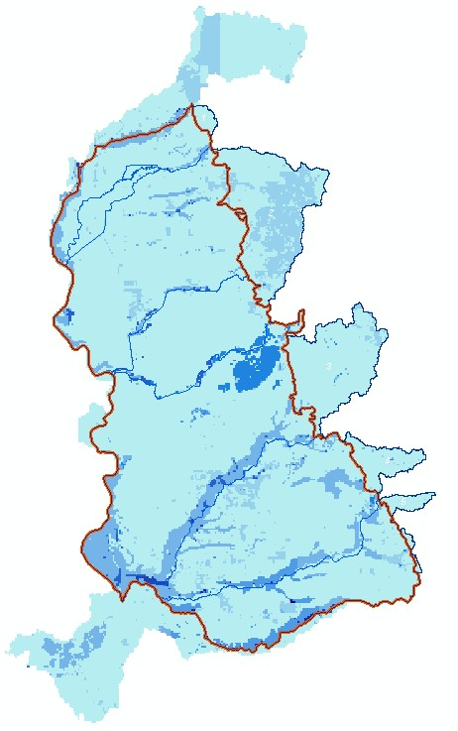
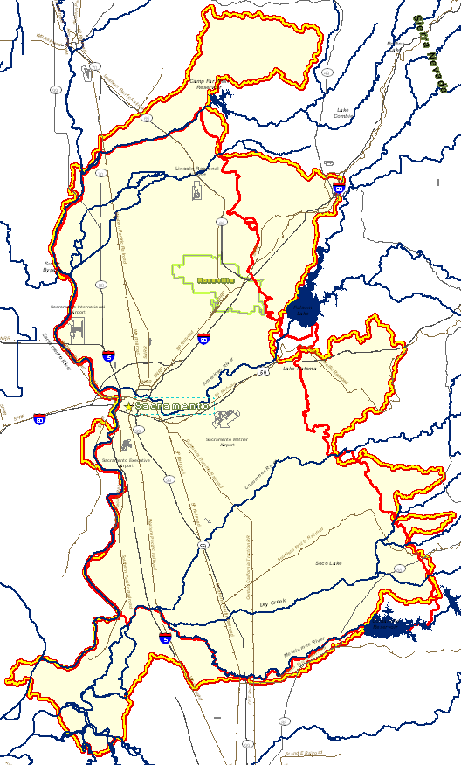

Simulated Recharge
1
2
3
4
5
6
7
Notes:
The map on the right indicates the recharge factors for the model domain. Darker colors indicate higher recharge potential. Much of the recharge in the region comes from alluvial deposits near streams and in the vicinity of abandoned placer mines.

Slide 14
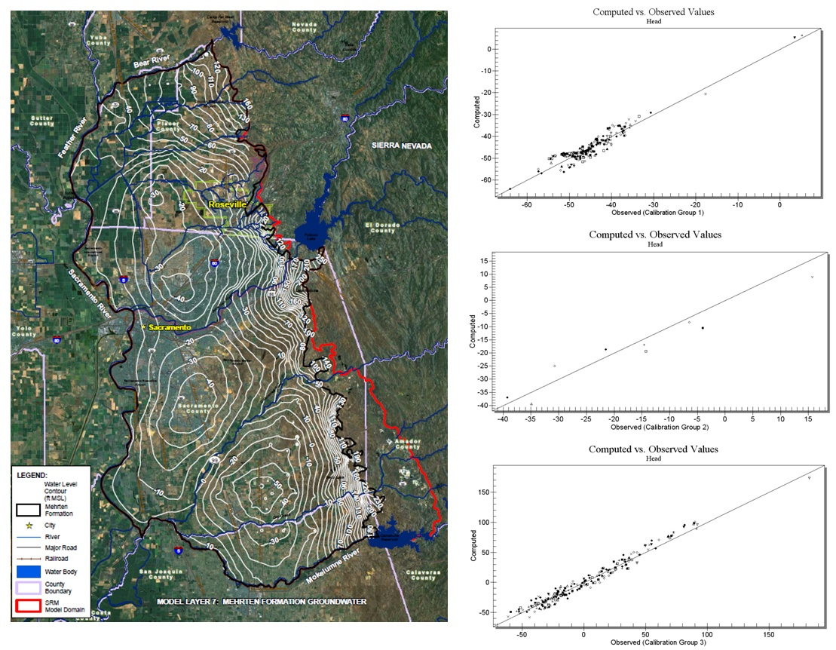
Steady State Calibration
Notes:
SRM model calibration was conducted in two phases: The first phase included a steady-state calibration using observations from water year 1998 (October 1997 through September 1998). The water year 1998 was selected for steady-state calibration because of the quantity of available data throughout the region during this period, thus reducing the uncertainties associated with supply and delivery information, land use classifications, and pumping activities prior to 1998 that impact the water budget for the model. The steady-state solution was then used as a baseline condition for the transient model. The transient calibration period extended from water year 1998 through water year 2008 (October 1997 through September 2008). The head contours resulting from the steady state calibration and scatter point diagrams of the observed and simulated heads are shown in this slide.

Slide 15
Predictive Model
October 2006 through September 2050
Monthly time steps
Two versions
With conservation measures
Without conservation measures
The Water Conservation Act introduced by Senator Steinberg sets a goal of reducing per capita urban water use by 20% by December 31, 2020, with an intermediate goal of reducing per capita water use by at least 10% by December 31, 2015.
Notes:
Once the transient model was calibrated successfully, models were developed to simulate future conditions (predictive models). The predictive models use water year 2007 from the calibrated transient model as a baseline and simulate aquifer response through water year 2050 (October 2006 through September 2050). Two separate predictive models were developed in order to assess impacts for future scenarios with and without demand conservation measures in place. Future demand with conservation includes reductions in per capita demand for municipalities in accordance with the proposed 2009 Water Conservation Act introduced by Senator Steinberg which sets a goal of reducing per capita urban water use by 20% by December 31, 2020, with an intermediate goal of reducing per capita water use by at least 10% by December 31, 2015. In accordance with the Sacramento Regional Water Master Plan, conservation measures for irrigation demand were guided by proposed goals of achieving incremental progress towards a 5% reduction in irrigation demands, achieved from improvements in irrigation efficiencies, by December 31, 2030. The Sacramento Council of Governments (SACOG) Blueprint 2005 and 2050 land use projections were used to establish the baseline and future land use trends. Land use trends were then interpolated from the two datasets throughout the predictive model simulation period. Population projections for per capita calculations were established using the latest demographic information provided by senior demographers at SACOG.

Slide 16
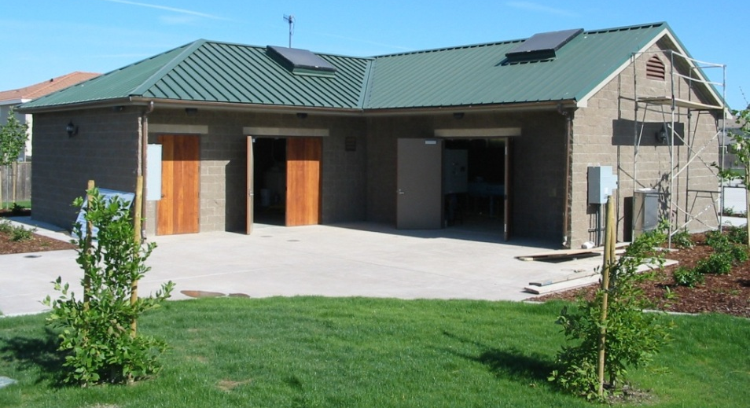
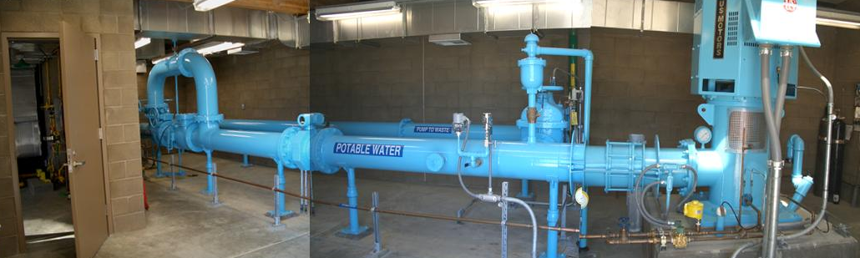
Aquifer Storage and Recovery
Notes:
A little background on the Roseville ASR program here.

Slide 17
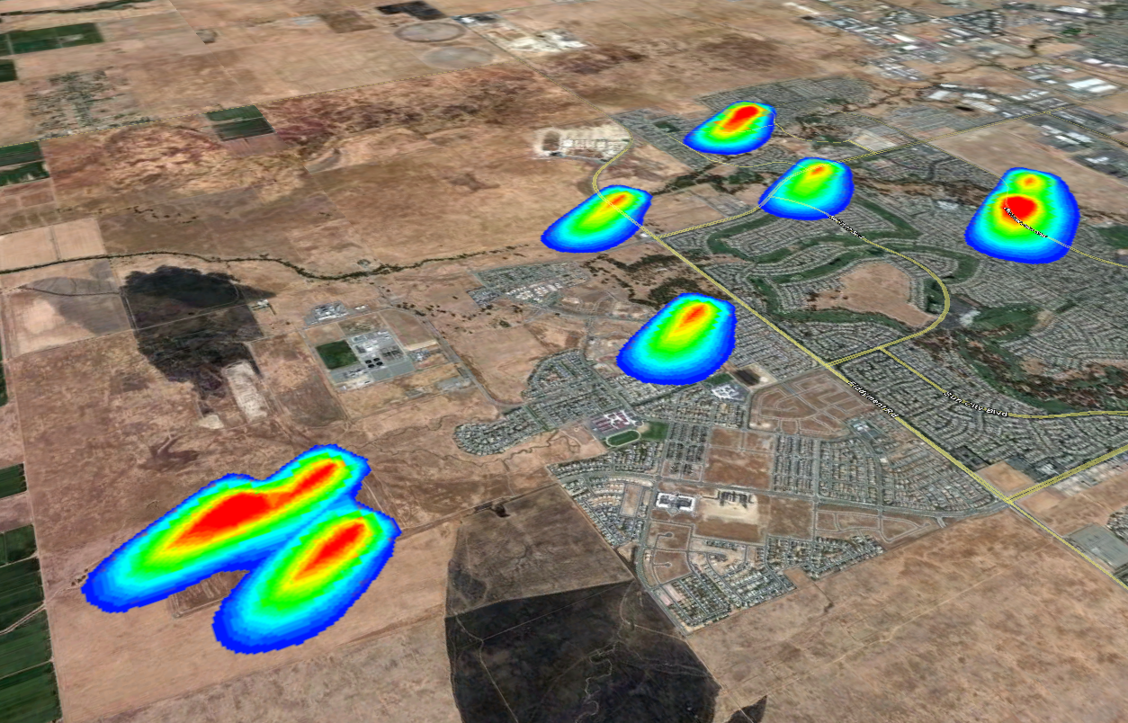
Sample Results
Notes:
(talk about current applications here)

